Slide 1

Human Resource Management System
Supervised By: Badhan Chandra Das Lecturer Bangladesh University of Business and Technology Dept. of CSE
Course Title : Software Development -1 Course Code : CSE 100
1
23 March 2021

Slide 2

OUR TEAM
1.Rahat Tamzid - 19202103511
2.Ashikur Rahman - 19202103492
3.Ehfaz Faisal Mahee - 19202103486
4. Sabiha Alam Samu - 19202103489
5. Tahira Akter Tamanna - 19202103502
6. Sultana Afreen Nitu - 19202103501
7. Tasmim Tayb Tusti - 19202103509
8.Soheba Akter -19202103484
2
23 March 2021

Slide 3
TABLE OF CONTENTS
1.What is HRMS
2.Our Objectives
3.Existing System vs. Proposed System
4.Software Design
5.Tools & Software Used
6.Modules
7.User Interface
8.Conclusion & Future Work
3
23 March 2021

Slide 4
What
1
IS HRMS?
4
23 March 2021

Slide 5
Human Resource Management System
A digital solution for managing and optimizing the daily human resources tasks.
It provides strategic advantage
Provides single, centralized view of a company’s workforce .
It maximizes employee performance by sorting all data efficiently.
5
23 March 2021

Slide 6
Our Objectives
2
6
23 March 2021

Slide 7
Our Objectives
To furnish the company with a overview of the data of the company
The project targets to simplify the record keeping of the employees.
The project aims at increasing the efficiency for retrieving information
7
23 March 2021

Slide 8
Existing System
3
VS Proposed System
8
23 March 2021

Slide 9
Existing System vs Proposed System
Human Resource Management
Existing System
Proposed SysTem
The records are maintained in registers
Aids in keeping the computerized employee details
Time Consuming Process
Keeping attendance digitally
Not easy to retrieve
Helps keep track of projects
Prone to error
Helps organize company resources
Increases of red tape
Help keep track of finances in the company
9
23 March 2021

Slide 10
04
Software Design
10
23 March 2021

Slide 11
Log in
Username password
Admin Dashboard
Employee Dashboard
Client Dashboard
11
23 March 2021

Slide 12
Admin Dashboard
Employee Menu
Financial Menu
Time Menu
User Menu
Project Menu
Add Pay Order
Clock in/out
Add User
Add Project
Add Employee
View Pay order
Generate Project Status
Time Tracking
View User
View Employee
Delete Pay order
Overtime Status
Update information
View Project Status
Edit Employee
Release Pay Order
View Single Employee Attendance
Delete User
Update Project Status
Generate Salary Sheet
Delete Employee
View Salary Sheet
Delete Project
Release Salary
All Projects
12
23 March 2021

Slide 13
Employee Dashboard
Time Menu
Project Menu
Generate Project Status
Clock in/out
View Project Status
View Attendance
Update Project Status
View Overtime
View Assigned Projects
13
23 March 2021

Slide 14
Client Dashboard
View Project Status
14
23 March 2021

Slide 15
Tools & Software Used
5
15
23 March 2021

Slide 16
Requirements
Minimum Hardware & OS Requirement:
Software We have used
Processor : Single Core Ram : 512 mb free Storage : 1GB free Operating System : Windows 7 or above.
IDE : Code Blocks Compiler : GNU GCC
16
23 March 2021

Slide 17
Functionality We have used
Function used :
Header File List
stdio.h
conio.h
string.h
ctype.h
windows.h
time.h
live time function
Coordinate function
Windows cmd command
Remove and rename function
Read and write text file
Space read base function
Local time month year finding function
Sprint for generating unique file value
User login data check and redirect
For Structuring
Looping,
TXT data format
17
23 March 2021

Slide 18
Modules
6
18
23 March 2021

Slide 19
Modules
1.Employee Menu
2.Financial Menu
3.Time Menu
4.User Menu
5.Project Menu
6.Software Manual
7.Exit
1.Time Menu
2.Project Menu
3.Exit
1. Project Menu
2.Exit
Client Modules
Employee Module
Admin Module
19
23 March 2021

Slide 20
Modules For Admin
Employee Menu
Add Employee
Admin can add a new employee with all basic information , salary , insurance coverage and job history.
View All Employee
Admin can see number of employees, employee ID , name , date of birth , NID ,Salary , insurance and rewards related information.
Edit Employee
Admin can edit all information of a existing employee
Delete Employee
Admin can delete a existing employee
20
23 March 2021

Slide 21
Modules For Admin
Financial Menu
Add Pay Order
Admin can add pay order where payment information is also added.
View Pay order
Here admin can see approved ,rejected and pending pay orders.
Payroll
Delete Pay order
Here admin can delete existing pay order information
Financial Menu
Release Pay Order
Admin can approve or reject pay order
Generate Salary Sheet
Here salary sheet for all employees will be generated automatically.
Salary Administration
View Salary Sheet
Generated salary sheet can be viewed here
Release Salary
From here the salary can be paid.
21
23 March 2021

Slide 22
Modules For Admin
Time Menu
Clock in/out
Clock in and out keeps a log of employee entry and exit times.
Time Tracking
Here total working time and overtime status can be viewed.
View Single Employee Attendance
It shows a table of the total working time
overtime status of a single employees.
22
23 March 2021

Slide 23
Modules For Admin
User Menu
Add User
Can add a new user for the software determining their role.
View User
Here user information and user role can be viewed.
Update User
Here user information and role can be updated.
Delete User
Existing User Can be deleted Here
23
23 March 2021

Slide 24
Modules For Admin
Project Menu
Add Project
New project can be added after receiving an order from the client.
Generate Project Status
Here project progress starting sheet is generated.
View Project Status
Here generated project status sheet is viewed.
Update Project Status
Here project status can be updated
Delete Project
Here any project can be deleted
All Projects
All current ongoing project can be viewed here.
24
23 March 2021

Slide 25
Modules For Admin
Software Manual
Software Manual
How to use this software
25
23 March 2021

Slide 26
Modules For Employee
Clock in / out
Clock in and out keeps a log of employee entry and exit times.
View Attendance
Here can be seen the clock in / out and total working time information
Time Menu
View overtime status
It shows overtime status of the employee.
Dashboard
Here project progress starting sheet is generated.
Generate Project Status
View Project Status
Here generated project status sheet is viewed.
Project Menu
Update Project Status
From here project status can be updated.
View Assigned Projects
Here all assigned project to a particular employee can be viewed
26
23 March 2021

Slide 27
Modules For Client
Client Can see project status
View Project Status
Client can see who is assigned to complete the project
27
23 March 2021

Slide 28
User Interface
7
28
23 March 2021

Slide 29
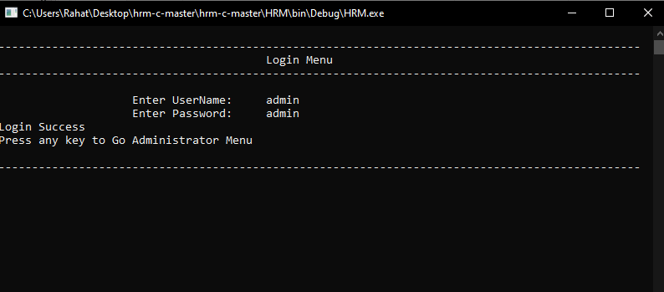
Login Screenshot
29
23 March 2021

Slide 30
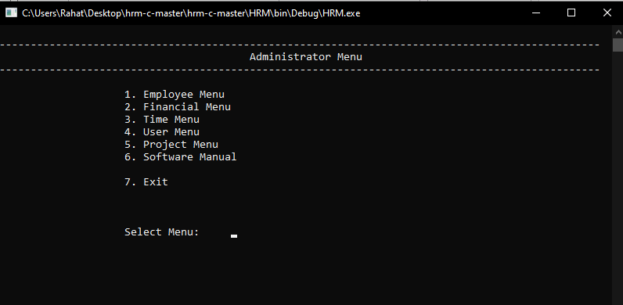
Administrator Menu Screenshots
30
23 March 2021

Slide 31
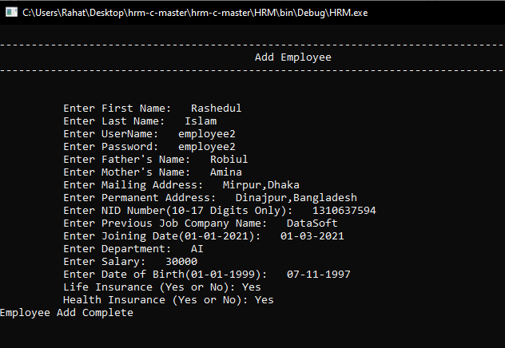
Add Employee Screenshots
31
23 March 2021

Slide 32
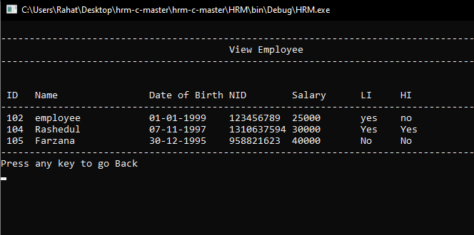
View Employee Screenshots
32
23 March 2021

Slide 33
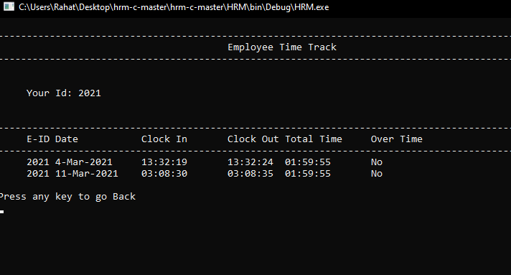
Time Tracking
33
23 March 2021

Slide 34
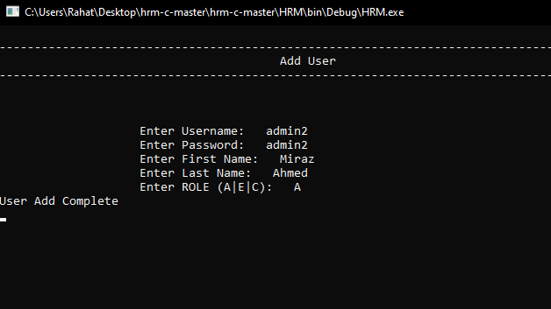
Add user
34
23 March 2021

Slide 35
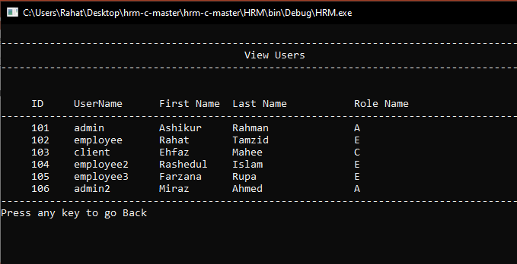
View User
35
23 March 2021

Slide 36
Conclusion & Future Work
8
36
23 March 2021

Slide 37
Future Work
Future Work: We will make it accessible to other pc and mobile using java and php.
By using internet the admin client and employee can interact each other over the internet. Our plan is to enhance this software further and add more features down the road. We will do-
API Integration
Convert it TO C++ and PHP.
Upgrade UI and UX.
More OS Support.
Database Module Integration
Report Management.
One to Many Data control.
Live Time Calculation Upgrade.
37
23 March 2021

Slide 38
Conclusion
Today software is being used in many kinds of sectors. Their operating process is changing daily. It is high time we use HRMS to increase the efficiency of the corporate sector and increase the national GDP. By decreasing the time needed to do official work.
38
23 March 2021

Slide 39
Thank You
39
23 March 2021

